Slide 1

Prediction Data-X: A Course on Data, Signals, and Systems
Data ^{X}
About Me:
Ikhlaq Sidhu Chief Scientist & Founding Director, Sutardja Center for Entrepreneurship & Technology IEOR Emerging Area Professor Award, UC Berkeley

Slide 2
Agenda
Introduction to Scoring and Linear Prediction (45 min)
Review of Graphing techniques with Matplotlib (45 min)
Team Selection and Project Work (remaining time)
Prepare for your low tech demo
Can be slide/picture of the interface
Explain any validation of user, summary of conversation on why they would use it and/or what they want from it.
HW for next week will be sent via bcourses in Notebook format:
HW includes project low tech demo: turn in (any form, slides, etc)
Review Ref Ref M01: Covariance and Correlation
Ref M05: Regression Analysis
Notebook versions available at data-x.blog in module-03

Slide 3
Introduction to Prediction

Slide 4
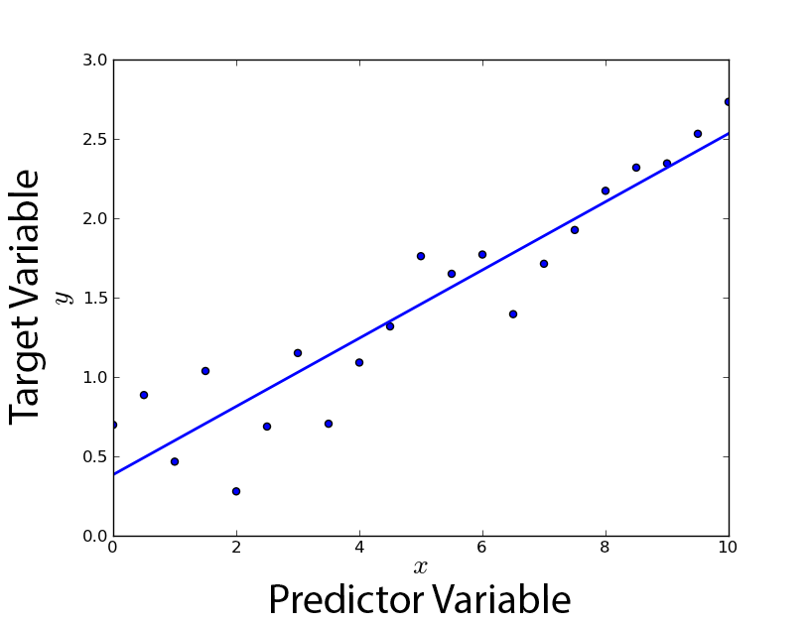
Prediction
Out of
Sample data x
Predicted y
Predictor
(formula)
Our Goal: Working with
out of sample data
Data We Might Have
(In Sample)

Slide 5
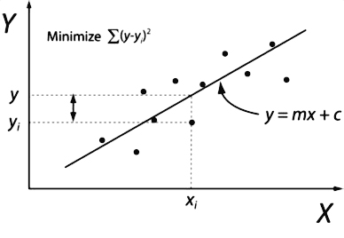
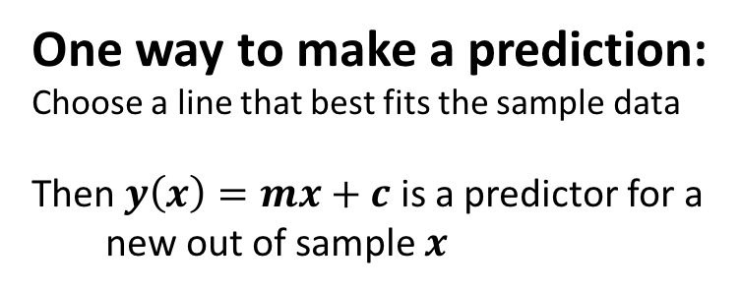
Prediction
One way to make a prediction:
Choose a line that best fits the sample data
Then $y\left(x\right)=mx+c$ is a predictor for a
new out of sample $x$
Data We Might Have
(In Sample)

Slide 6
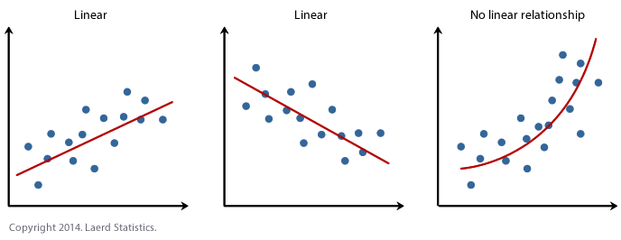
Of Course, we can not assume that all data can be predicted by a linear model
Model might be a poor fit (wrong model)
Model might be too good of a fit or over-fit (only works well on the
in sample data)
Image: Laerd Statistics, 2014

Slide 7
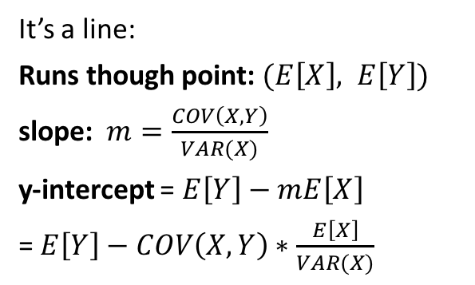
Best Linear Predictor (if you just have 2 Variables)
This turns out to be the best linear predictor:
It’s a line:
Runs though point: $(E\left[X\right], E\left[Y\right])$
slope: $m=\frac{COV\left(X,Y\right)}{VAR(X)}$
y-intercept = $E\left[Y\right]−mE\left[X\right]$
= $E\left[Y\right]−COV\left(X,Y\right)∗\frac{E\left[X\right]}{VAR(X)}$
Remember:
COV(X,Y) = E[ (X-μ_{x}) (Y-μ_{y}) ]
COV(X,Y) = E [X Y ] – E[X] E[Y]
COV(X,X) = VAR(X)
COV(AX,Y) = ACOV(X,Y)
What makes this the the best linear predictor?
How much error does this predictor have?
Notes:
We want a line
Intercept and slope
What if Y = X: slope = COV(X,X)/VAR(X)
How about Y = 2X
COV intuition: every point contributes positive value when in quadrants 1,3, and higher numbers close to the diagonal
Denominator: VAR (X): small makes a larger slope
Numerator: larger COV makes slope higher

Slide 8
Simple Example: Calculate best linear predictor
Data Set in a Table, two variables
X | Y
2 | 10
4 | 5
3 | 9
5 | 4
6 | 3

Slide 9
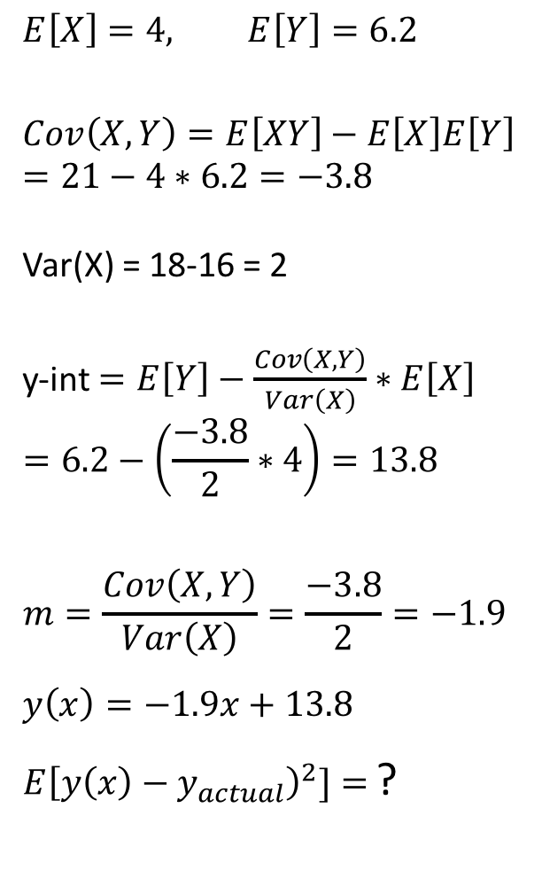
Example: Data Set in a Table 2 variables
$$E\left[X\right]=4, E\left[Y\right]=6.2$$
$$Cov\left(X,Y\right)=E\left[XY\right]−E\left[X\right]E\left[Y\right]$$
$$=21−4∗6.2=−3.8$$
Var(X) = 18-16 = 2
y-int $=E\left[Y\right]−\frac{Cov\left(X,Y\right)}{Var\left(X\right)}∗E\left[X\right]$
$$=6.2−\left(\frac{−3.8}{2}∗4\right)=13.8$$
$$m=\frac{Cov\left(X,Y\right)}{Var\left(X\right)}=\frac{−3.8}{2}=−1.9$$
$$y\left(x\right)=−1.9x+13.8$$
$E{\left[y\left(x\right)−y_{actual}\right)}^{2}]=$?
X | Y | X*Y | X^2 | y(x)
2 | 10 | 20 | 4 | 6.96
4 | 5 | 20 | 16 | 3.92
3 | 9 | 27 | 9 | 5.44
5 | 4 | 20 | 25 | 2.4
6 | 3 | 18 | 36 | 0.88
E[X] | E[Y] | E[XY] | E[X^2]
4 | 6.2 | 21 | 18
Notes:
Line
Need slope -> need cov and var
Table has xy, x^2, y^2, y + means
Let the students calculate
E([y(x)-y_actual)²] = *ANSWER*
Y(1) = 13.8-1.9 = 11.9

Slide 10
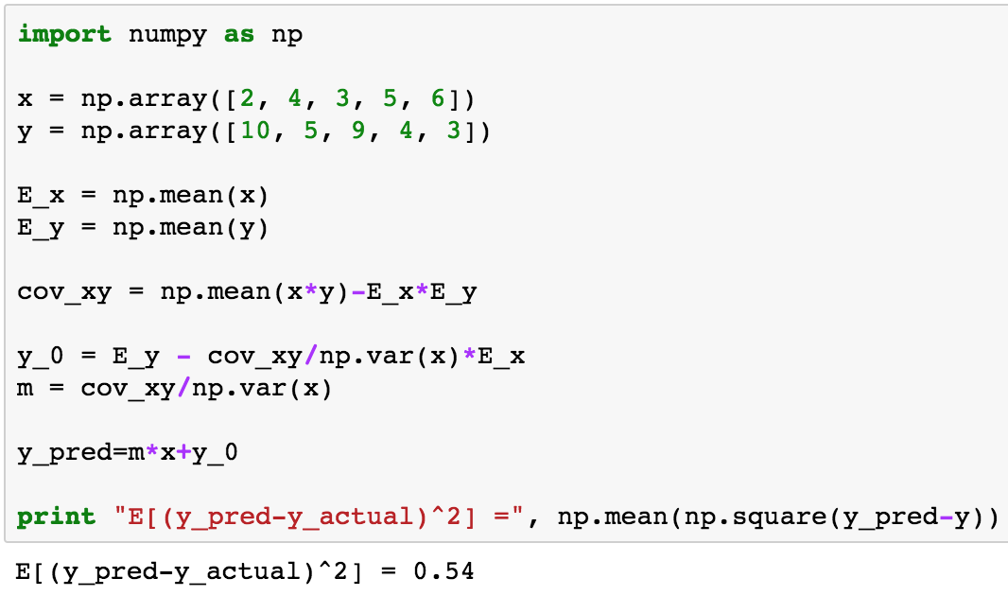
Code Sample
Notes:
Code to illustrate, but in reality, you don’t have to write this

Slide 11
Prediction: Multiple Inputs and Outputs
Predicted Y = [y1 y2 y3]
Out of
Sample
X=[x1 x2 ..xn]
Out of
Sample
x
Predictor
(formula)
Predictor
(formula)
Predicted y
No problem,
we use multiple predictors.
y1 = g1(x)
y2 = g2(x)
y3 = g3(x)
?
Notes:
So this solves the problem for 2 variables: 1 in and one out
What if we have 1 input, multiple outputs – no problem
Now lets consider multiple inputs (multiple columns of input in the table)

Slide 12
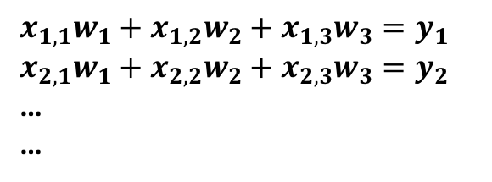
Prediction: Multiple Inputs and Outputs
Out of
Sample
X=[x1 x2 ..xn]
Predictor
(formula)
Predicted y
In this case, for linear prediction, we use a matrix format:
X
(Nxd)
$$x_{1,1}w_{1}+x_{1,2}w_{2}+x_{1,3}w_{3}=y_{1}$$
$$x_{2,1}w_{1}+x_{2,2}w_{2}+x_{2,3}w_{3}=y_{2}$$
…
…
W (dx1)
Y
(Nx1)
.
=
1 3 4 6 2
x_{i}
X is the in-sample data. We only need to figure out W. With W, we can estimate y for new x, i.e. out of sample data
Notes:
Now we use a table with a row as the multiple inputs Xi
Instead of slope M, we will use weights W, or the vector W
Dimensions X is N deep, W is d deep (number of dimentions), Y has one result for every row N.
But what happened to the y intercept concept?

Slide 13
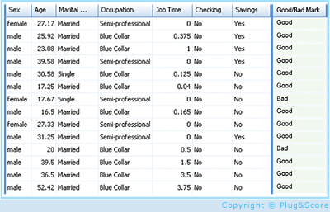
An ML Framework
X
(Nxd)
Y
Nx1
Results in Y
(which we know
for N samples)
Sometimes measured
Y includes error or noise
Y = f(X) + e()
We don’t know:
P(X), the distribution of X
Function f:
f: X->Y
In Sample Data which we have
d features
N samples
Use for training
f(X)
Features: (d columns)
Age, income, zip code, ..
Person 1
Person 2
Person 3
Person N
In Sample
Out of Sample
N rows:
each row has customer information
d features
Y has a value of interest
Credit score: a number
Classification: “good customer”
vs “poor customer”

Slide 14
An ML Framework
X
(Nxd)
Y
(N x 1)
Results in Y
(which we know)
Sometimes measured
Y includes error or noise
We don’t know:
P(X), the distribution of X
Function f:
f: X->Y
In Sample Data which we have
d features
N samples
Use for training
We use this to train: (x1,y1), (x2,y2)…(xN,yN)
Final Hypothesis
Algorithm:
Pick a g(x)
g: x->y predictor or classifier
H = Hypothesis Set All Possible Algorithms
Candidate Formulas
Error measure
We try different functions g until
g(x) is close to f(x)
For any out of sample x, we can predict a y or classify it

Slide 15
An ML Framework
We use this to train: (x1,y1), (x2,y2)…xN,yN)
Final Hypothesis
Algorithm
new g(x)
g: x->y predictor or classifier
H = Hypothesis Set All Possible Algorithms
Candidate Formulas
Error measure
Actual
Estimated
g(x) is our estimate of f(x)
One way to measure error: Error(g) = E[f(x)-g(x)] over all in-sample x.
This Error(g) is a type of loss function, there are many loss functions
Error_in_sample(g) is expected to be similar to Error_out of sample[g)
Notes:
We need to be able to measure error: loss function
We assume error in sample will be error of out of sample

Slide 16
Example: Prediction with Regression
Data: x(i,1) x(i,2) x(i,3) y(i,1)
ID Name Age years w employer Income Credit Score
John 25 3 50 660
Alice 23 2 60 580
Bill 28 1 80 425
Rahul 25 .5 59 320
W
w0
w1
w2 w3
X
(N x d+1)
1 25 3 50
1 23 2 60
1 28 1 80
1 25 .5 59
Y
Nx1
660
580
425
320
We are now going to
choose a W that gives us a predictor
for Y
.
=
This time, Y is the actual value we want to estimate
Notice: we added an extra column of 1s?
Notes:
We will do an example of scoring/regression
Regression simply means that the function simply estimates the score or y value
We will choose not just one number , but all the values in W to best predict Y
The extra column of 1s and w0, allow w0 to be the bias, like the y intercept

Slide 17
Example: Prediction with Regression
W
w0
w1
w2 w3
X
(N x d+1)
1 25 3 50
1 23 2 60
1 28 1 80
1 25 .5 59
Y
Nx1
660
580
425
320
This time, Y is the actual value we want to estimate.?
X₂
.
=
Train with this to “calculate” W
Predictor:
g(x) = XW
Out of sample (a row of numbers)
Estimated y (a real number)
X_{i}
Then predict (or classify) with W
Notes:
Then any row can be used as input as a prediction: x2 dot W = estimated value of Y (in place of 580).
Clearly a linear prediction

Slide 18

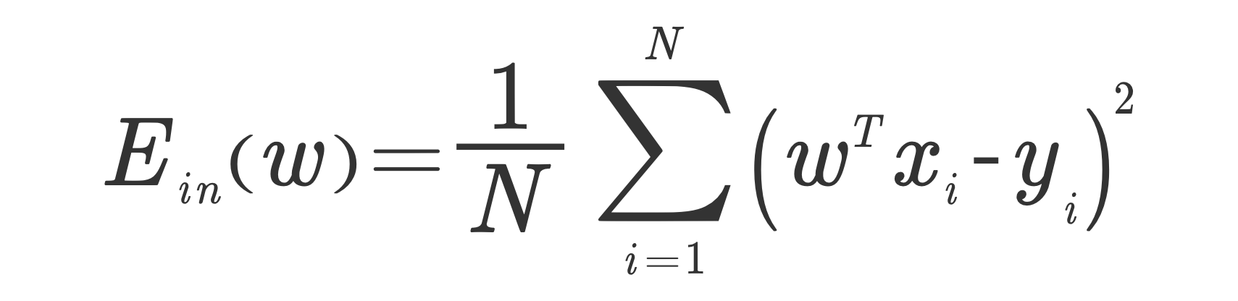
The Math: Linear Regression
Predictor:
g(x) = XW
OK, but better to
measure squared error
T
Notes:
The problem with straight subtraction:
The average of lots of negative error and positive errors can be zero
Squares are good because errors smaller than one are minimized and errors larger than 1 are exaggerated, outliers show more error

Slide 19
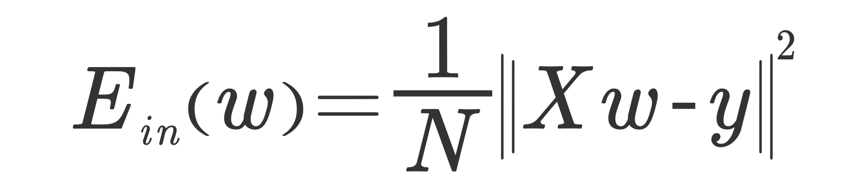
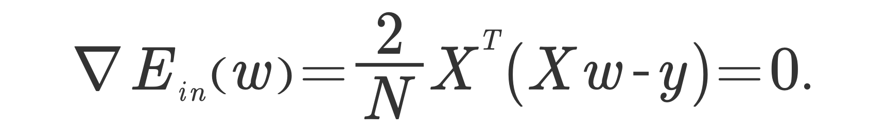
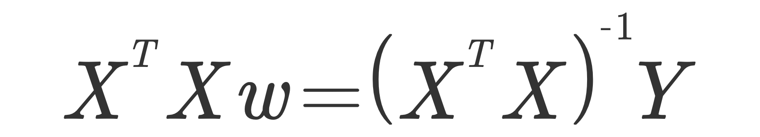

X = Nxd
X^{T} = dxN
T
(X^{T}X) ⁼
dxd
(X^{T}X)⁻¹ ⁼
dxd
W = (X^{T}X)⁻¹ X^{T} Y=
Y= Nxm
outputs
=
dxd
.
dxN
.
dxm
= [dxN] x [Nxm] =
Y estimated = X W =
W = (X^{T}X)⁻¹ X^{T} Y
Xout is Nout x d
Nout x m
.
W = dxm
=
Y _{estimated} = X _{out of sample} W

Slide 20
Example 2: Prediction with Regression
W
w0
w1
w2 w3
X
(N x d+1)
1 25 3 50
1 23 2 60
1 28 1 80
1 25 .5 59
Y
Nx1
660
580
425
320
This time, Y is the actual value we want to estimate.?
X =
.
=
Train with this to “calculate” W
W = X ^{Ŧ}Y = (X^{T}X)⁻¹ X^{T} Y
Predictor:
g(x) = XW
Out of sample (a row of numbers)
Estimated y (a real number)
X _{i}
Then predict (or classify) with W

Slide 21
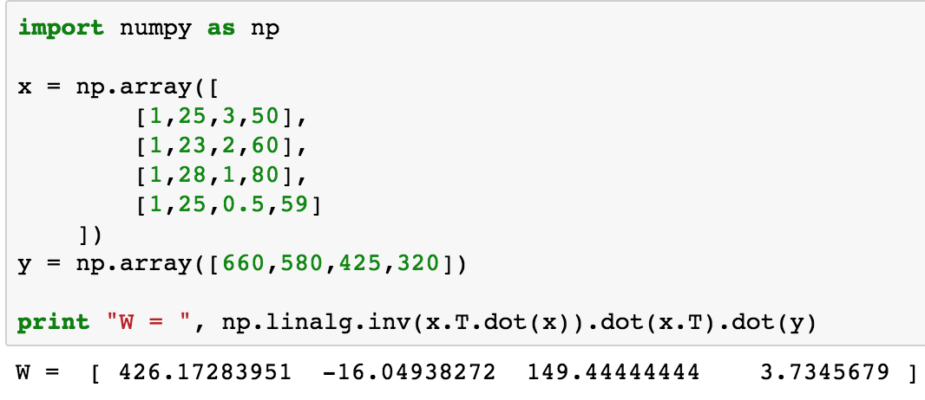
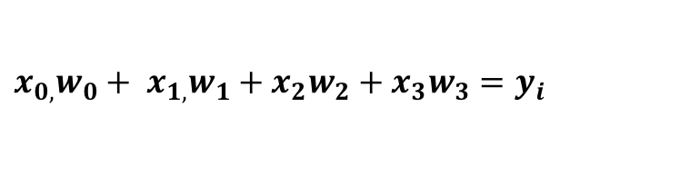
Code Sample
$${x_{0,}w_{0}+ x}_{1,}w_{1}+x_{2}w_{2}+x_{3}w_{3}=y_{i}$$
Data: x(i,1) x(i,2) x(i,3) y(i,1)
ID Name Age years w employer Income Credit Score
John 25 3 50 660
Alice 23 2 60 580
Bill 28 1 80 425
Rahul 25 .5 59 320
Notes:
Note the 1s column
Simple code, no library
W has coefficients: bias and for each dimension, there is only one output value, credit score

Slide 22
In the ML framework, there is no limit to the predictors or classifiers that can be used.
We use this to train: (x1,y1), (x2,y2)…(xN,yN)
Final Hypothesis
Algorithm:
Under test
g: x->y predictor or classifier
H = Hypothesis Set All Possible Algorithms
Candidate Formulas
Error measure
g can be chosen from,
Linear estimators:
Any weighted sum
The best fit line or plane
Non-linear functions:
Neural Networks
MLE
Any function
We try different functions g until
g(x) is close to f(x)
For any out of sample x, we can predict Y or classify it

Slide 23
End of Section

